Slide 1

WESAD Dataset analysis & optimize
WEEK 2 Yongrun Huang
Tianyi WU

Slide 2
Basic info
I. General information Contact persons: Philip Schmidt and Attila Reiss, contact at: firstname.lastname@de.bosch.com. If you publish material based on this dataset, please reference the publication [1].
I.1. Dataset structure The dataset is organised so that each subject has a folder (SX, where X = subject ID). Each subject folder contains the following files: - SX_readme.txt: contains information about the subject (SX) and information about data collection and data quality (if applicable) - SX_quest.csv: contains all relevant information to obtain ground truth, including the protocol schedule for SX and answers to the self-report questionnaires; see details below - SX_respiban.txt: contains data from the RespiBAN device; see details below - SX_E4_Data.zip: contains data from the Empatica E4 device; see details below - SX.pkl: contains synchronised data and labels; see details below
I.2. Subjects 17 subjects participated in the study. However, due to sensor malfunction, data of two subjects (S1 and S12) had to be discarded. Thus, the respective folders are missing in WESAD. Information on each subject can be found in SX_readme.txt, in the respective subject’s folder. Please refer to [1] for overall information on the subjects (see Section 3.1 there).
2022 IEEE Healthcare Innovations and Point of Care Technologies (HI-POCT)
March 10-11, 2022. Texas A&M University - EnMed, Houston, TX, USA
A Wearable Exam Stress Dataset for Predicting Grades using Physiological Signals

Slide 3
Data from RespiBAN
The RespiBAN Professional was used: http://www.biosignalsplux.com/en/respiban-professional. Please refer to [1] for details on sensor placement (see Section 3.2 there). All signals were sampled at 700 Hz. Raw data is contained in SX_respiban.txt. There are 10 columns here. First column: sequential line number. Second column: ignore. Columns 3-10: raw data of the 8 sensor channels. The order of the channels is defined in the header. The entries “XYZ” refer to the 3-channel accelerometer (thus, acceleration data is provided in 3 columns). In order to convert the raw sensor values into SI units, each channel has to transformed based on the formulas given below (signal contains the raw sensor values, vcc=3, chan_bit=2^16).
- ECG (mV): ((signal/chan_bit-0.5)*vcc) Details: http://www.biosignalsplux.com/datasheets/ECG_Sensor_Datasheet.pdf
- EDA (μS): (((signal/chan_bit)*vcc)/0.12) Details: http://www.biosignalsplux.com/datasheets/EDA_Sensor_Datasheet.pdf
- EMG (mV): ((signal/chan_bit-0.5)*vcc) Details: http://www.biosignalsplux.com/datasheets/EMG_Sensor_Datasheet.pdf
- TEMP (°C): vout = (signal*vcc)/(chan_bit-1.) rntc = ((10^4)*vout)/(vcc-vout) - 273.15 + 1./(1.12764514*(10^(-3)) + 2.34282709*(10^(-4))*log(rntc) + + 8.77303013*(10^(-8))*(log(rntc)^3)) Details: http://www.biosignalsplux.com/datasheets/TMP_Sensor_Datasheet.pdf
- XYZ (g): (signal-Cmin)/(Cmax-Cmin)*2-1, where Cmin = 28000 and Cmax = 38000 Details: http://www.biosignalsplux.com/datasheets/ACC_Sensor_Datasheet.pdf
- RESPIRATION (%): (signal / chan_bit - 0.5) * 100 Details: http://www.biosignalsplux.com/datasheets/PZT_Sensor_Datasheet.pdf
Data from Empatica E4
The Empatica E4 was used: http://www.empatica.com/research/e4/. The E4 device was worn on the subjects’ non-dominant wrist. Sampling rate of the different sensors was different, see below. Raw data is contained in SX_E4_Data.zip. When unzipped, the following files contain derived information and thus should be ignored in this dataset: HR.csv, IBI.csv, tags.csv. The file info.txt contains some details on the folder’s content. Raw data from the E4 device is contained in the following files (in each file, first line refers to the sensor channel’s global timestamp at start, second line refers to the sensor channel’s sampling rate):
- ACC.csv: sampled at 32 Hz. The 3 data columns refer to the 3 accelerometer channels. Data is provided in units of 1/64g.
- BVP.csv: sampled at 64 Hz. Data from photoplethysmograph (PPG).
- EDA.csv: sampled at 4 Hz. Data is provided in μS.
- TEMP.csv: sampled at 4 Hz. Data is provided in °C.

Slide 4

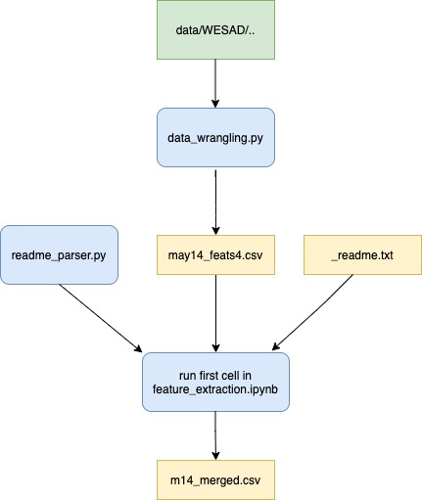
Basic model
https://github.com/WJMatthew/WESAD

Slide 5
Latest relative paper
Abstract- Stress, a pervasive psychological state, profoundly impacts individuals' well-being and may lead to various health issues. In this paper, the WESAD (Wearable Stress and Affect Detection) dataset serves as the primary data source, from which HRV (Heart Rate Variability) data extracted using PPG (Photoplethysmography) sensor is utilized. This data can be obtained in a non-invasive method and is instrumental in this analysis. The dataset comprises HRV data from 15 individual test subjects obtained from PPG sensors, providing a crucial foundation for the detection and classification of individuals into
"stressed" or "not stressed" categories, thus offering a valuable tool for stress monitoring. This paper is a focused exploration into the CNN (Convolutional Neural Network) Deep Learning model, in which the feature selection process is carried out using Random Forest resulting in the selection of HR (Heart Rate), LF_BOXCOX (Low-Frequency Component - Box-Cox Transformed), MEDIAN_RR (Median of RR Intervals), SD1_BOXCOX (Standard Deviation 1 - Box-Cox Transformed), and SDRR_REL_RR (Standard Deviation of Relative RR Intervals) to optimize the model's performance. The model aims at advancing and refining stress detection methodologies to enhance overall well-being and achieves an accuracy of 98%. Keywords: Stress, WESAD Dataset, PPG sensor, non-invasive method, HRV, CNN, feature selection, Random Forest, HR, LF_BOXCOX, MEDIAN_RR, SD1_BOXCOX, and SDRR_REL_RR.
Stress Detection Using CNN on the WESAD Dataset
- 2024 International Conference on Emerging Systems and Intelligent Computing (ESIC) -

Slide 6

THANK YOU

